Slide 1

What are the School Council focusing on this year?
CHILDREN’S RIGHTS
What is a ‘right’?
A right is a freedom that you are entitled to. These are often written in law and should be protected.
E.g. Human rights are the basic rights and freedoms that belong to every person in the world, from birth until death.

Slide 2
What are the School Council focusing on this year?
This year the School Council will focus on different rights to champion each term/half term to ensure you know what you and ALL children are entitled to.
So far this year, the school has focused on:
Article 27/42: You have the right to a good enough standard of living. This means you should have food, clothes and a place to live.
So far this year, the school council has focused on:
Article 12/42: You have the right to an opinion and for it to be taken seriously.

Slide 3

‘You have the right to an opinion and for it to be taken seriously’
1 x the field/MUGA
1 x Henry’s Garden

Slide 4
What other rights will we be looking at?
You have the right to be with friends and join or set up clubs, unless this breaks the rights of others.
You have the right to play and relax by doing things like sports, music and drama.
If you come from a minority group, because of your race, religion or language, you have the right to enjoy your own culture, practise your own religion, and use your own language.

Slide 5
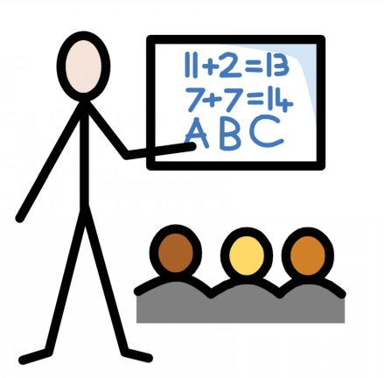
Education
Article 28 of the UNCRC says that children and young people have the right to education no matter who they are: regardless of race, gender or disability; if they’re in detention, or if they’re a refugee

Slide 6
What do you think this number stands for?
244 million
New data from the United Nations Educational, Scientific and Cultural Organization (UNESCO) shows that an estimated 244 million children aged between 6 and 18 are still out of school around the world. Sub-Saharan Africa and Central and Southern Asia are the regions with the highest numbers of out-of-school learners. (2022)

Slide 7
The Pros and Cons
How would not going to school, and being deprived of your right to education, affect your life?
PROS
Sleep in until whatever time you like!
Become amazing at video games!
Spend lots of time with your parents!
CONS
Never learn to read or write
Never learn how to make friends, socialise and play
Never be able to work with numbers
Probably be inactive, unfit and unhealthy
Never learn the importance of respect, punctuality and working hard
Parents can’t earn as much money as they’re busy looking after you

Slide 8
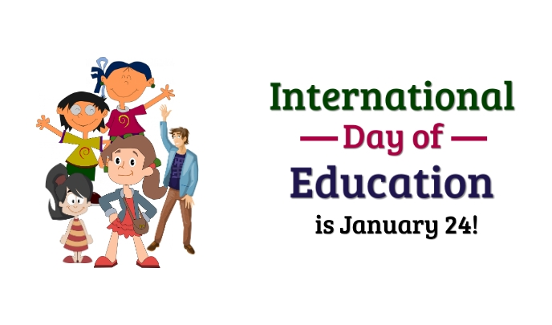

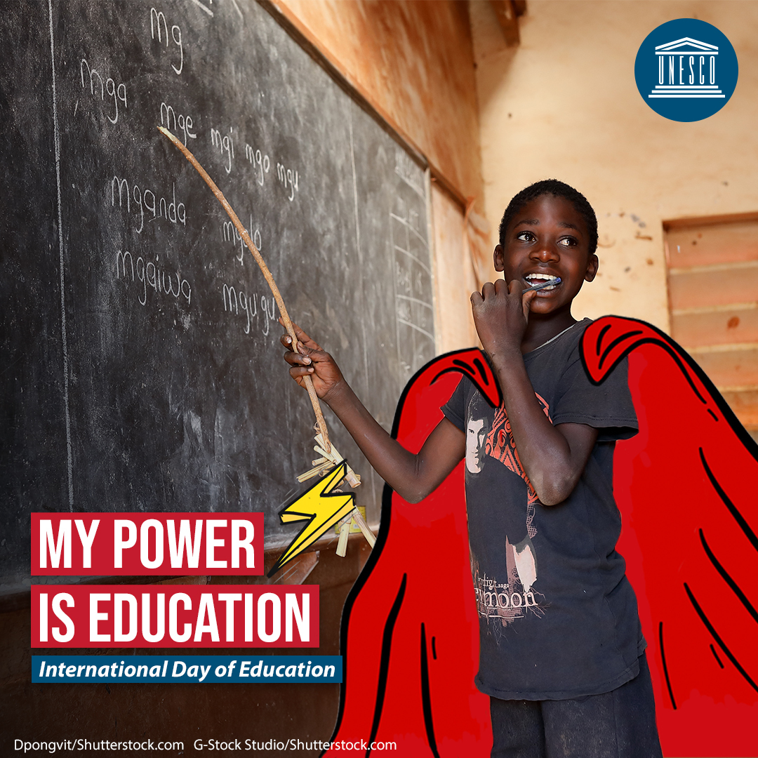
International Day of Education
Highlights the importance of education for all
Illustrates how lucky children are in Britain to be able to go to school and learn

Slide 9
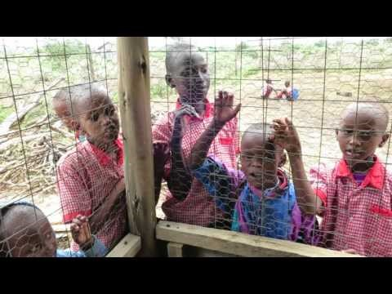

Slide 10

“The roots of education are bitter, but the fruit is sweet.” – Aristotle

