Slide 1

SCHOOL COUNCIL:
CLASS FEEDBACK

Slide 2

What are the School Council focusing on this year?
CHILDREN’S RIGHTS
What is a ‘right’?
A right is a freedom that you are entitled to. These are often written in law and should be protected.
E.g. Human rights are the basic rights and freedoms that belong to every person in the world, from birth until death.

Slide 3
What are the School Council focusing on this year?
This year the School Council will focus on different rights to champion each term/half term to ensure you know what you and ALL children are entitled to.
So far this year, the school council has focused on:
Article 12/42: You have the right to an opinion and for it to be taken seriously.

Slide 4
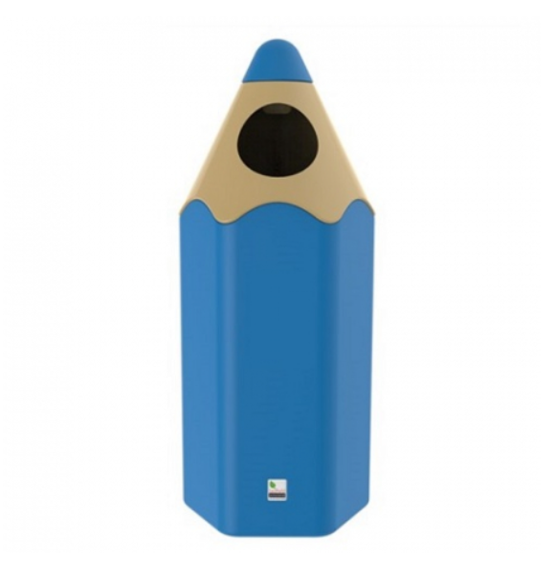
The School Council listens!
In your class surveys, a lot of you mentioned more bins as a way of improving the school.
We currently have three on the playground, but none in Henry’s Garden or near the MUGA/field.
We will now as two new bins have been ordered. How will this improve the school?

Slide 5
What other rights will we be looking at?
You have the right to play and relax by doing things like sports, music and drama.
In order to support your right to play (especially at wet play times when boredom sets in) each class will be given £80 to decide upon the things YOU want to play with.
The School Council are currently drafting ideas about how to raise this money through a sponsored event of some sort!
How would you like to spend this money? What would be good for your classroom?

