Slide 1

our best eco books by the Eco Council 2023
The Willows Primary School
Eco Focus Autumn (2) 2023

Slide 2

Willows Eco News
We are now able to recycle;
old glasses (any frames, any lenses and cases in any condition)
contact lens waste (lenses, their plastic containers and the foil lids)
Please NO cleaning cloths, spray, solution bottles, bags or boxes)

Slide 3

More Willows Eco News
Mrs Harry has told me about some of the children in KS2 who have been working hard at Brownies to help the environment.
They all earned a Blue Peter Eco Badge for their efforts. Well done!
The Eco Council will award you all an Eco Warrior certificate at the next Congratulations Assembly.

Slide 4
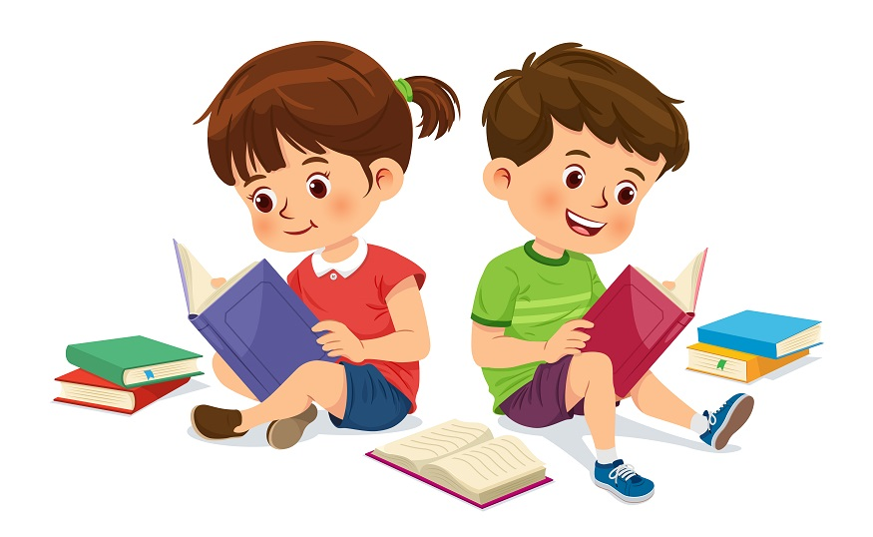
We love to read at The Willows!
The Eco Council are eager to share their passion for looking after the environment. So in our last meeting we talked about books that inspired us.
Here are their recommendations to you.
If you like the look of one, why not put it on your Christmas list and join us in being Eco Warriors!
Top tip: Buy your books second hand to reduce waste!

Slide 5
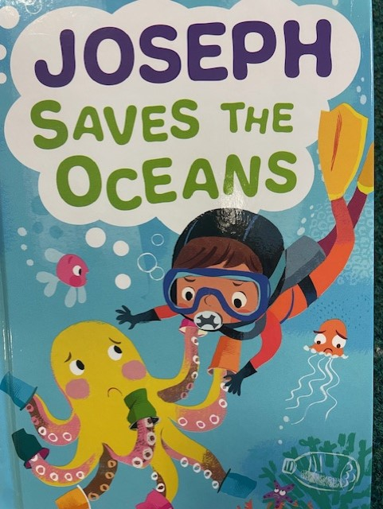

Joseph recommends…
“I like this book because I love the ocean and diving and seeing fish. And it has my name in it! It teaches you how to save the ocean from plastic litter.”

Slide 6
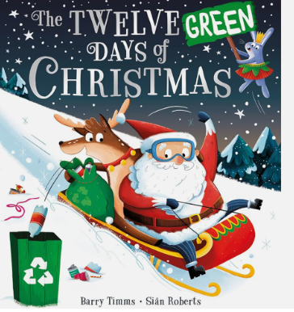
Rafi recommends…
“This book is silly and funny, but it has an important message;
PICK UP LITTER!”

Slide 7
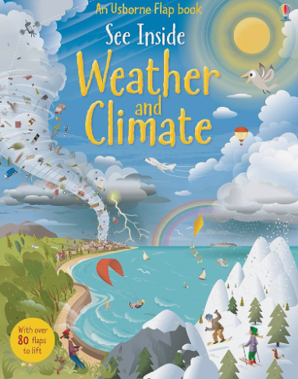
Harry recommends…
“This book tells you about where weather comes from, world climates, rain and clouds, wind and ice. Also how people affect the weather.”

Slide 8
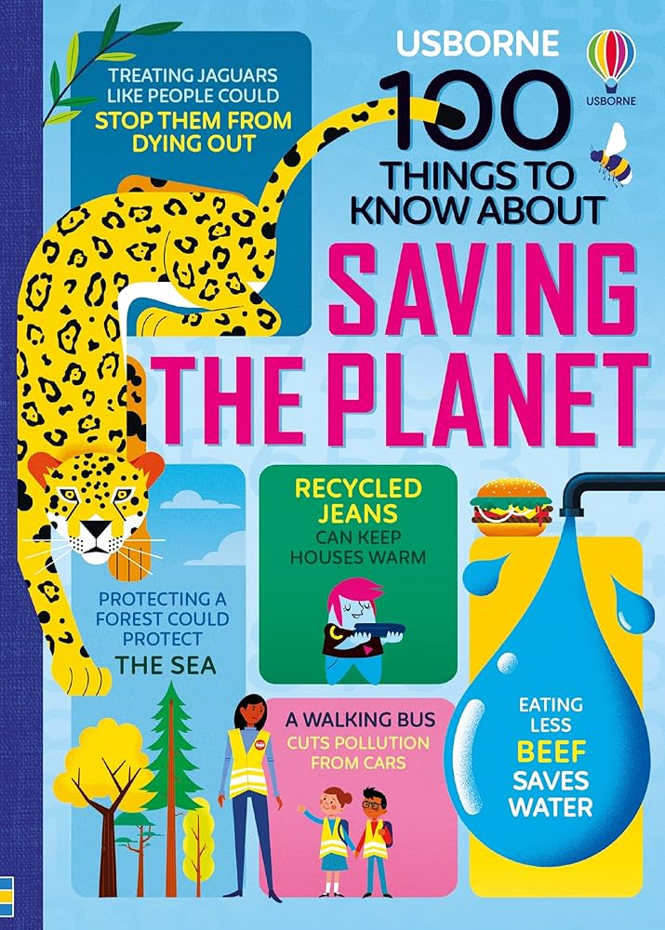
Albie recommends…
“This is an information book. I like all the facts in it. It tells you what you can do to protect our planet.”

Slide 9
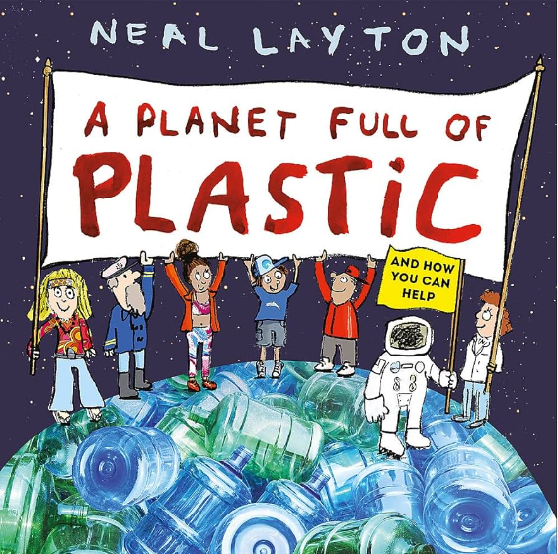
Hugo recommends…
“Plastic is everywhere, and it's hurting Planet Earth - but we can all help to make things better! This book gives you easy ideas for how to reduce our use plastic.”

Slide 10
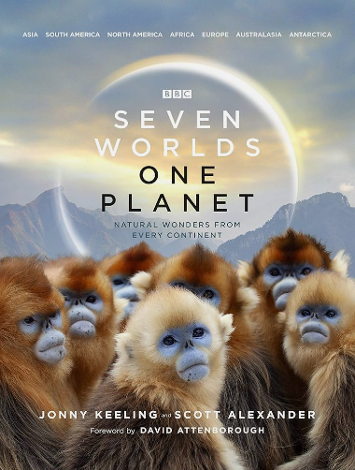
Eddie recommends…
“I love this book because it is about animals. It shows how some animals have been able to adapt to climate change. The pictures of the animals are amazing!”

Slide 11
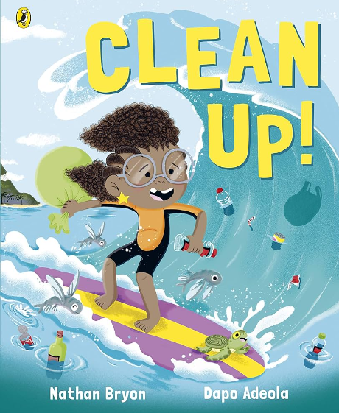
Max recommends…
“This book lets everyone know that they must clean up on the beach so that sea life doesn’t die or get sick.”

Slide 12

Sol recommends…
“It is an adventure story, but is also full of fascinating facts. It is very exciting and you learn about global warming too.”

Slide 13
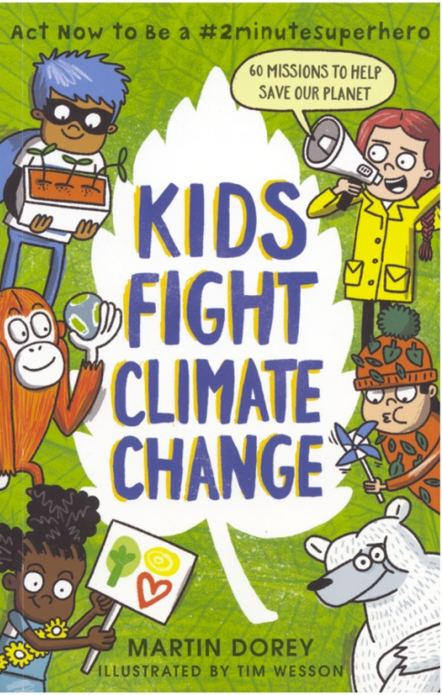
Sienna
recommends…
“I like this book because it is full of interesting facts like... Switching to oat, almond and soya milk may not be as environmentally friendly as you think! In this book you can be an eco superhero and do fun missions to reduce your carbon footprint.”

Slide 14
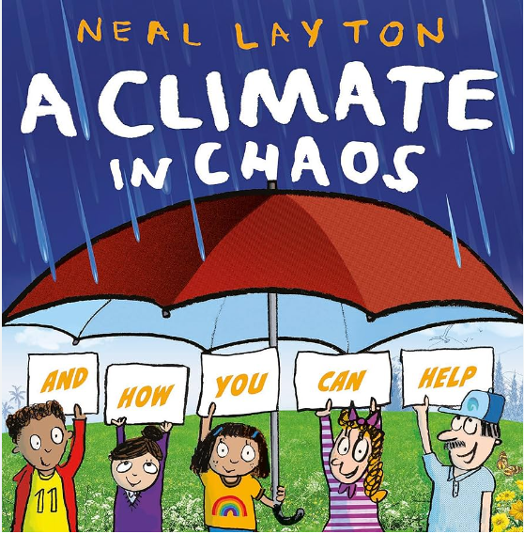
Owen recommends…
”The pictures in this book are really interesting and it shows you how you can save the planet.”

Slide 15
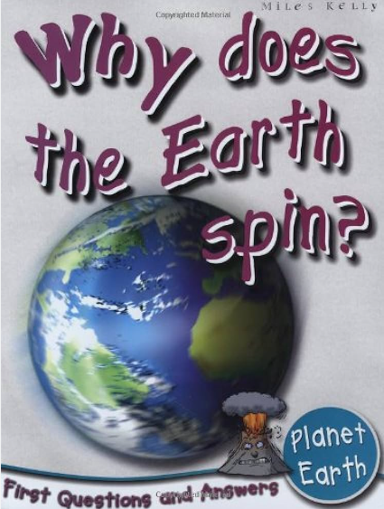
Niamh recommends…
“I like this non-fiction book because it’s easy to read and not too heavy. I love the pictures. Some of the science might be too tricky for young children to understand, but KS2 will enjoy it.”

Slide 16
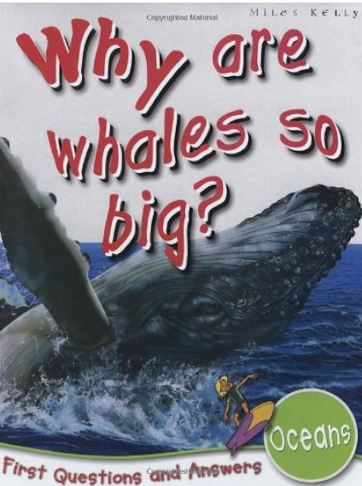
Jennie recommends…
“I like this book because I love the ocean and I am keen to protect it. It has cartoons and quizzes which makes it fun and interactive.”

Slide 17
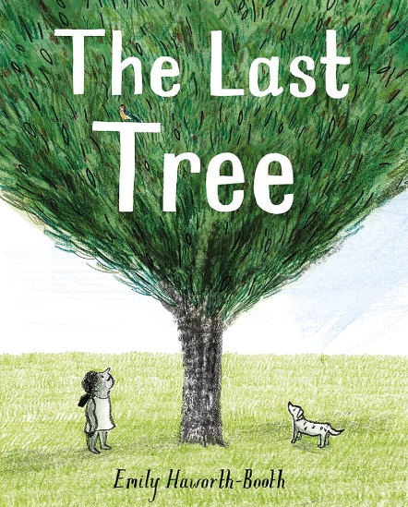
Mrs Pashley recommends…
“This book is about what might happen if we cut down all the trees. But there is hope; some children fight against this and try to save the last tree.”

Slide 18
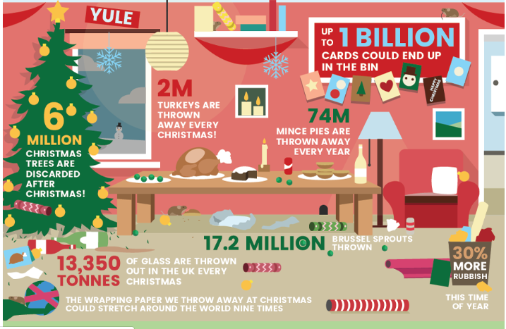
Merry Eco Christmas!

Slide 19
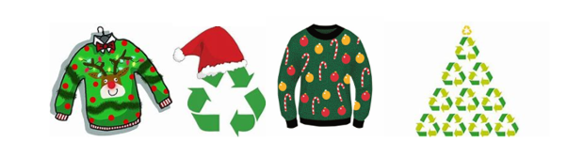
Merry Eco Christmas!
Save money and reduce waste this Christmas….
Get your Christmas jumpers from the PTA!

Slide 20


