Slide 1
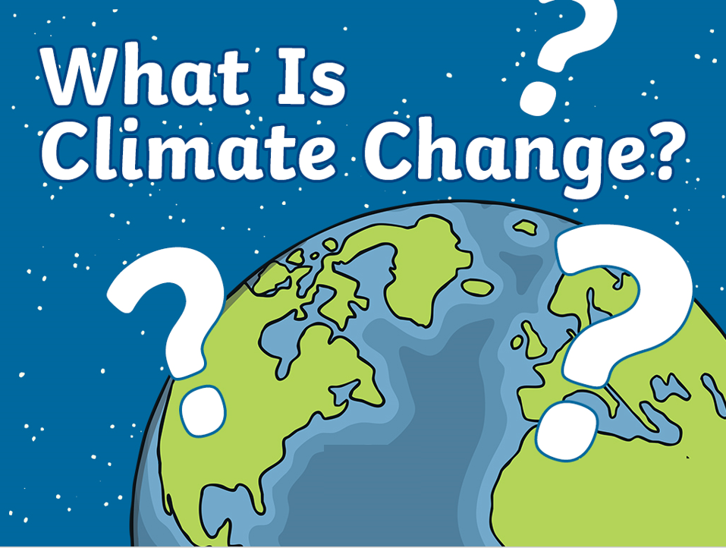


Slide 2

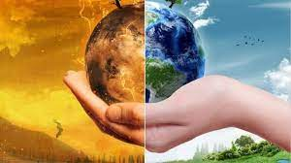
What Is Climate Change?
Climate change is a term to describe the changes in the Earth’s weather and temperatures over time.
It includes global warming, which is the rise in temperatures all over the world due mainly to more greenhouse gases in the atmosphere.
The effects of climate change are a huge challenge for us and our planet.

Slide 3
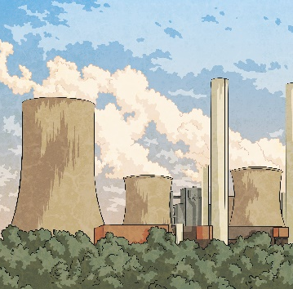
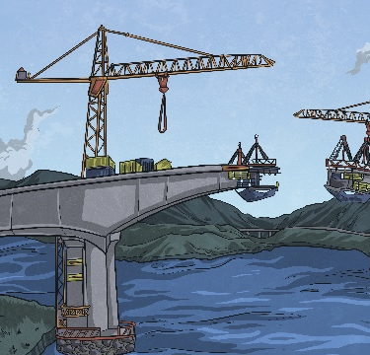
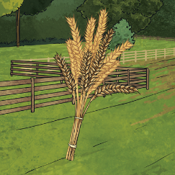
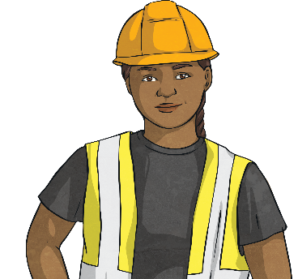

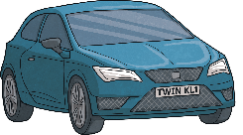
Why Is the World’s Climate Changing?
Over the past 200 years, industrialisation and a growing population has led to the release of more gases that cause rising temperatures
These include:
1
2
3
4
Electricity
and Heat
Manufacturing and Construction
Farming
Transportation
These actions can also lead to the destruction of nature, including deforestation. Trees and green spaces give us oxygen and habitats for animals.

Slide 4

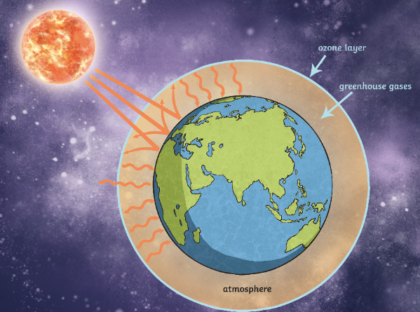
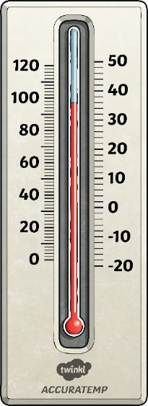
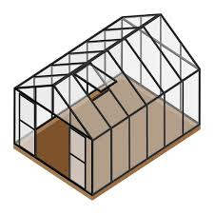
How Do Greenhouse Gases Change the Climate?
Just like a greenhouse, the Sun’s rays can enter the Earth’s atmosphere, but then become trapped inside by greenhouse gases.

Slide 5
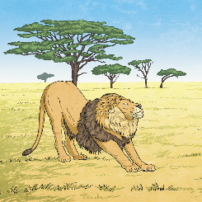
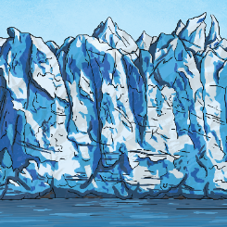
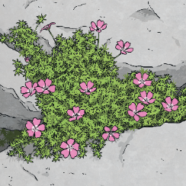



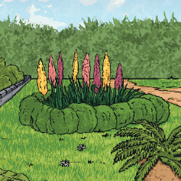
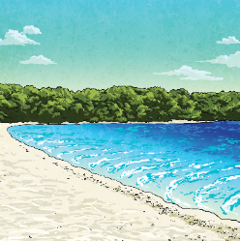

What Is Being Affected by
Climate Change?
Global warming is the main cause of climate change. The effects of climate change include:
Plant species shifting locations
5
1
Animal species becoming endangered
4
Shrinking glaciers
3
Trees and plants flowering much earlier in the year
2
Rising sea levels

Slide 6
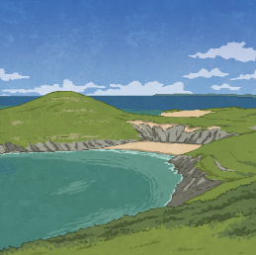
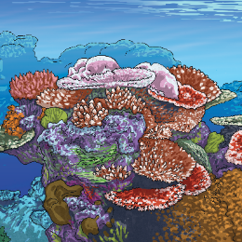
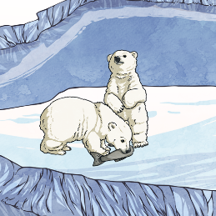
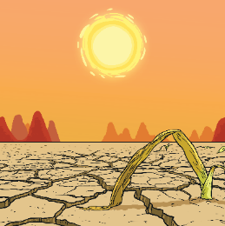
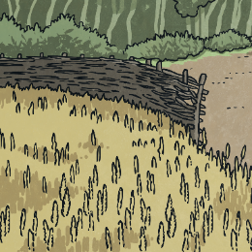
What Are the Consequences of Not Doing Enough?
Unless we slow down global warming, experts have predicted there are some very serious consequences for our planet.
5
2
Up to 90% of the ocean’s coral reefs will become lifeless.
1
4
Low-lying settlements and habitats might become flooded.
3
Up to 30% of the Earth’s wildlife could become extinct.
Droughts and storms become more frequent and extreme.
Crops dependant on rain will halve.

Slide 7
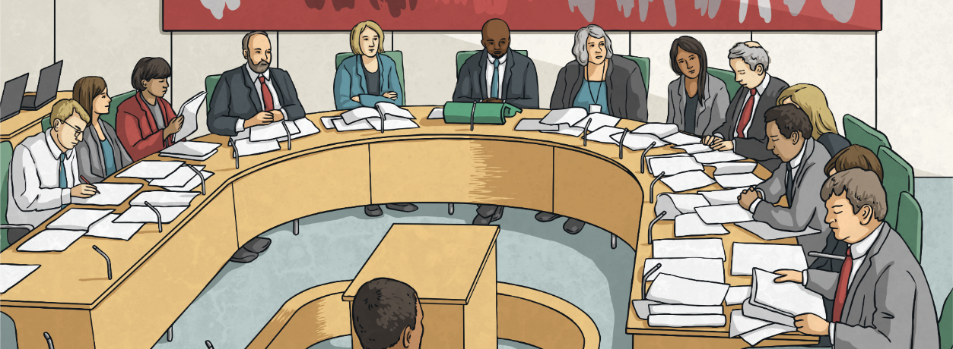
What Is Being Done to Combat Climate Change?
To stop further climate change, global warming must be tackled.
Most major countries around the world have adopted strict laws that are meant to
reduce the amount of greenhouse gases
being produced.

Slide 8

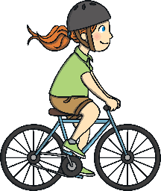
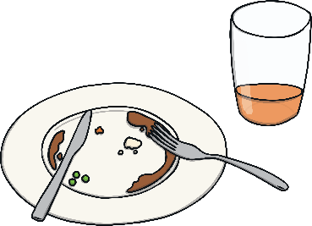



How Can We Help?
Everybody must do their bit. This is our Earth that we share. We only have one and we need to look after it.
Use cars less.
Reduce, Reuse, Recycle
Cars pollute the air. Walk or cycle to school.
Reuse what you don’t need any more. Waste less and recycle where you can.
Use less electricity.
Switch off electrical items when you are not using them. Leaving them on standby uses electricity!

Slide 9
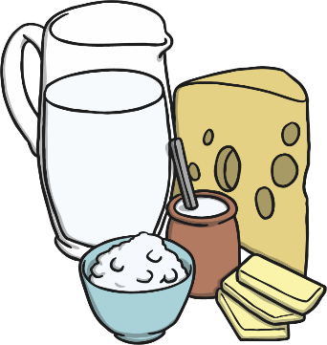
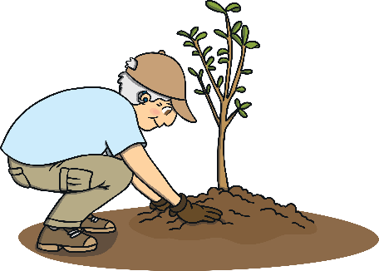
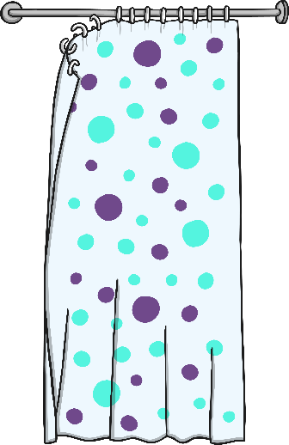
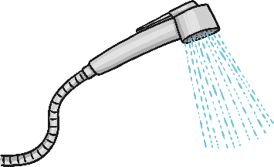
How Can We Help?
Everybody must do their bit. This is our Earth that we share. We only have one and we need to look after it.
Plant a tree.
Eat less meat and dairy.
Use less water. Have a quick shower instead of a bath.

Slide 10


