Slide 1
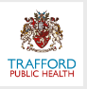
You and Covid
Information you might know, don’t know but should know about covid
Notes:
The school and local public health team are working together to help reduce the number of people at our school and in our community who become poorly with covid.
We wanted to talk to you about some of the things that are in place and why we do them-so you can help us too.

Slide 2
Mental Wellbeing
www.trafforddirectory.co.uk/vmwh
Links & information on mental health and wellbeing
Links to support available in your local area
Virtual Mental Wealth Hub
To speak to a Youth Worker about anything at all (Relationships, health and wellbeing, etc.)
Call 0161 912 2453 or email talkshop@trafford.gov.uk
Talkshop, Streetalk and Connexions
Anonymous online counselling, advice and mental health support. Register online at: https://kooth.com/
Kooth
1:1 support and also group and creative projects you can get involved with https://www.42ndstreet.org.uk/online-support.html
42nd Street
Times have been really tough for lots of us during the COVID pandemic
Whilst it is normal to feel a whole range of emotions right now, if you’re feeling worried, anxious, stressed, sad or angry there is always support available for you
Speak to someone you trust about how you are feeling if you can. This might be a friend, parent or teacher
There might be someone at your school you can talk to in confidence
Find information and support – see suggestions opposite and also have a look at the pages on https://youngminds.org.uk/
If you’re really struggling text: SHOUT to 85258
Free support 24/7
Anonymous
(won’t show up on the phonebilll)
Notes:
Emotions are a normal part of being human – it’s normal for us to feel worried, scared, stressed, angry, sad or even happy at times during a difficult time
Lot’s of us have experienced lots of changes in our lives
We might have lost someone close to us
We might not be able to do the things we normally enjoy e.g. seeing friends, going to the cinema, hanging out
If you are experiencing some difficult feelings, please speak to someone you trust. It might be a friend, sibling, parent or teacher. It may be that you prefer to speak to someone you don’t know e.g. someone who support with these issues at your school or your GP
INSERT LOCAL SCHOOL EXAMPLE e.g. school nurse/designated safeguarding professional
There is lots of support available to you online, over the telephone and face to face right now. This hasn’t stopped due to the pandemic.
We are here to support you throughout this time.
The Young Minds Website is one good place to get self-help or ideas on how you can support yourself throughout this time. They have lots of blogs written by young people on various topics e.g. friendships, relationships, coping through covid, gender and identity.
If you find you are really struggling and feeling overwhelmed. Please text SHOUT to 85258. If it is urgent, attend A&E
We have an online support offer KOOTH where you can talk online to trained counsellors. Just sign up on the website, that’s it.
We also have youth workers who you can speak to about just about anything! Anything that’s bothering you or even if you just need some information on what other support is available.
42nd Street also offer 1:1 support with trained mental health practitioners. However, they also have lots of groups and creative projects that you can get involved with right now. Have a look at their website.
The Virtual Mental Wealth Hub basically brings lots of information together on where you can find support. There are videos from lots of our local services explaining what they offer and how to get help.

Slide 3
What’s different from last year?
I can’t get close to people I don’t live with
Our classes can’t mix with other classes in school
We can’t have events, concerts, parties or lots of people in school
I haven’t hugged my grandparents and other people I don’t live with
I feel worried about Covid
I have had to self-isolate
I can’t hang out with my friends
I can’t have sleepovers
I am washing my hands loads
I was tested for covid
Lots of people have to wear masks
And lots more………

Slide 4
Words or phrases you’ll be hearing loads
Social distancing-standing away from other people, at least 2 mtrs, no hugging them or getting close to them unless we live with them.
Self isolation- not going out for either 10 days if you have Covid or 10 days if you have been told we are a contact
PPE-personal protective equipment, the masks, gloves and aprons used by the doctors and nurses
Vaccination-the medicine used to help protect us from Covid, it has started to be given to people in December
Covid-coronavirus
Testing- the way of confirming someone has Covid or not
Case-someone who has tested positive for Covid
Contact-someone who has been near someone who has had Covid-there are definitions of what who is a contact

Slide 5
So what is covid?
Coronavirus or covid is an illness that affects people’s breathing and lungs.
It can be spread from person to person by coughing or by touching surfaces or areas of skin that have been contaminated by the virus.
This is why we socially distance, wear masks and wash our hands

Slide 6
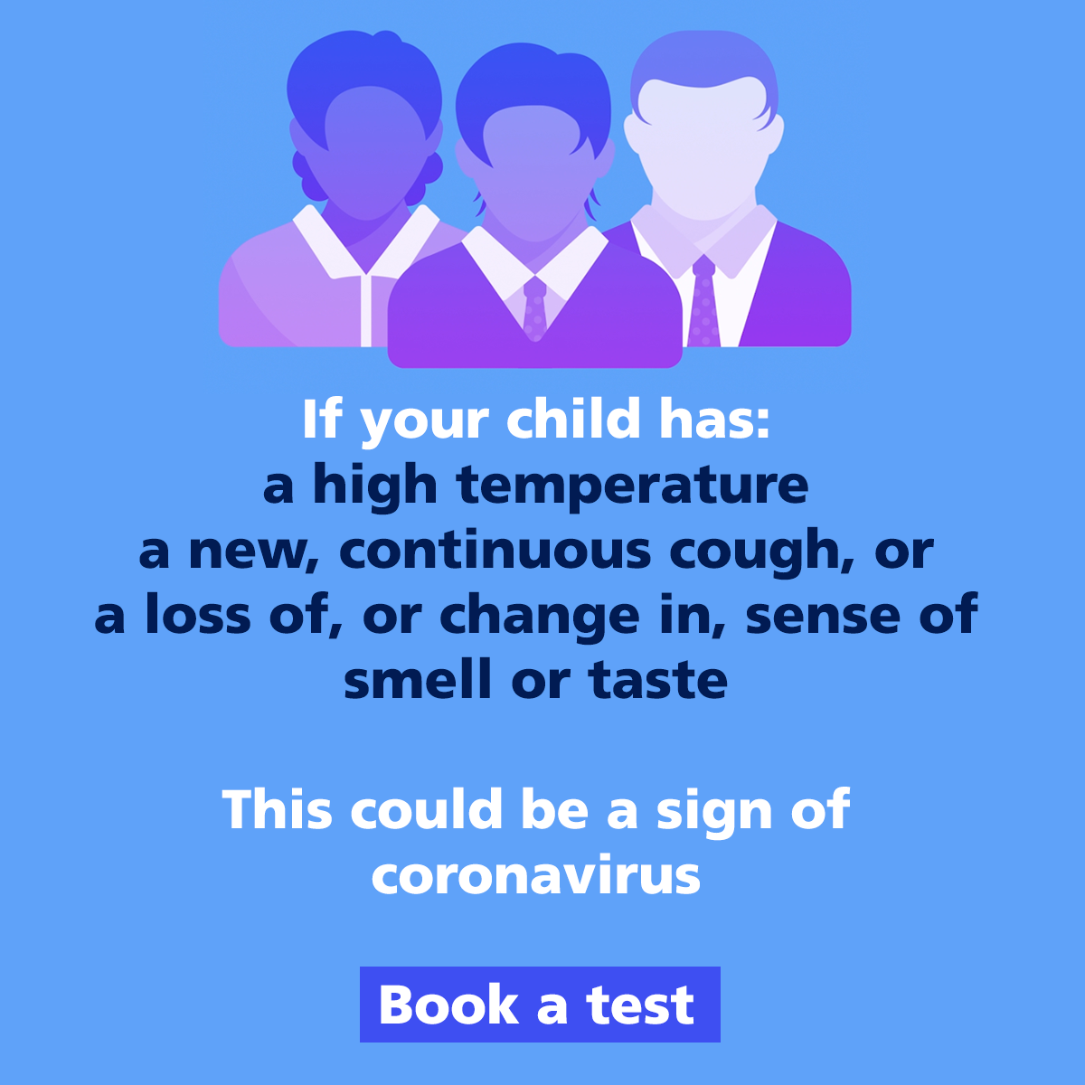
How do I know I have covid?
Notes:
Main symptoms are high temperature, new and continuous cough, loss or change in taste and smell
Got for a test
Don’t worry it may not be covid, if it is covid don’t worry

Slide 7
What happens if I get Covid
Children and young people who get covid will usually only get a little ill, like a cold. Many don't get ill at all.
The same goes for mum and dad or your carer, if they get it. Grown-ups with healthy bodies are not likely to become very ill.
But covid can be dangerous to people who already have serious diseases. It can also be dangerous to those who are elderly.
That is why we must do everything we can to protect them from getting it.
We have to work together to stop it spreading

Slide 8
Why we socially distance
When we talk, cough, sneeze or sing small droplets will be spread out of our mouths.
They can land up to one metre away from our bodies.
By staying away from others we won’t breathe in their droplets and they won’t breathe in ours.
Therefore we won’t pick up the virus from them.
Hugging or touching people you don’t live with means you are really close to them and you will breathe in their droplets or pick up droplets on your hands and body.

Slide 9
Why we wash our hands
If you don’t catch your coughs and sneezes in a tissue and safely dispose of it, the virus can end up on surfaces. If someone else touches that contaminated surface, the virus can transfer onto their hand.
If you have the virus on your hands, you can infect yourself by touching your eyes, mouth or nose.
You might think that you don’t touch your face very often, but it’s much more than you realise. A 2015 study found that people touch their faces an average of 23 times an hour, (BBC Science, 2020)
Wash your hands for 20 seconds and use soap as the virus likes soap and will stick to it and then be washed away when you rinse your hands.

Slide 10
Why do we wear face coverings?
Face coverings reduce the spread of droplets from you if you have the virus, even if you don’t know that you do.
When out of the house and wearing a face covering, you still need to socially distance.
Children under 11 don’t have to wear face coverings and some adults are exempt from wearing face covering because of a health reason, which means they don’t need to wear them.

Slide 11
What is a contact and what does it mean?
A contact is someone who has been close to someone who is infectious (case) and may have breathed in or ingested the virus via their droplets
You are a contact if you have been close to a case in the two days before they became ill, or had a positive test result if they didn’t have any symptoms. To be a contact you might have;
  travelled in a car with them
  been within 1 metre for 1 minute of them, ( a length of a guitar for 60 seconds)
  had physical contact, touched, hugged, had close face to face conversation, been coughed on by the case
  been within 2 metres of the case for 15 minutes
    The average adult in the UK is 1.75 metres tall, imagine one of your adults, (parent, carer, teacher) lying on the floor between you and the other person. With a little bit of space either end, would they fit? If yes that’s good.
Your list of contacts are those people who may become ill from the virus. If they do become ill then their contacts self-isolate to prevent to chain of the infection getting longer.

Slide 12
Why do we self-isolate?
By self-isolating the virus has no where new to go!
If someone in your house has symptoms, you all have to self-isolate until the test result is know-if negative everybody is free-if positive….
  If you have covid you self isolate for 10 full days after becoming unwell or after having the test if you have no symptoms
  If you are a contact you self-isolate for 10 days after you had the last contact with the case
Self-isolation stops the infection (droplets) spreading, breaks the transmission, disrupts the virus…
Contacts self-isolate for 10 days to include the incubation (when the virus is growing in the body) and the infectious period (when other people can catch it from the person who has it). If they become poorly they start isolating for 10 days (as above)

Slide 13
Bubbles in and out of school
Bubbles allow schools to keep pupils and staff together and reduce the amount of people who could become infected.
During lunch and breaks you might be with people who aren’t in your learning bubbles
You might walk to school and home with a different group of friends
Try not to mix with lots of your friends outside school even if they are in your bubble as people belong to more than one bubble and that is when the infection spreads……..
Have fun with your friends in school but remember 2 metres-socially distancing is the most important way to prevent spread.

Slide 14
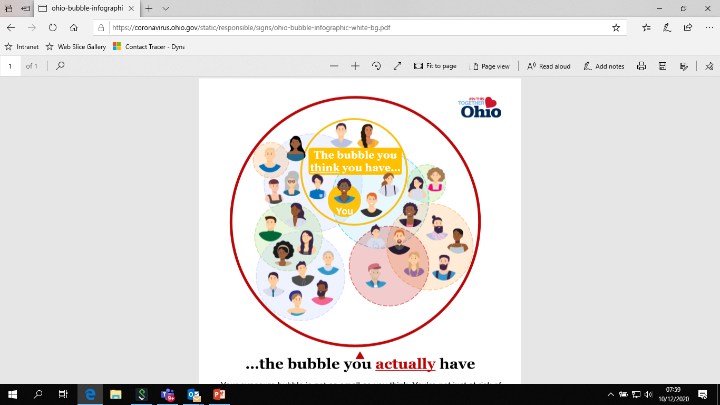
Notes:
Think about the bubbles you belong too. If you got covid how many people could be a contact?
So you have your school bubble, home bubble, football bubble, friendship bubble…..
Your friend in your school bubble, who is a contact, has their home bubble, school bubble, friendship bubble, work bubble, dance class bubble……
A friend in your football bubble, goes to a different school and has their bubble, home bubble and so on
You parents are in a bubble with you at home, have a work bubble, faith bubble, gym bubble and so on…..
If you got covid how many people could be a contact, remember the 48 hours rule?

Slide 15
Learning challenge
Think about the last two days;
How many people did you spend 15 minutes within 2 metres distance?
How many people did you spend 15 minutes within 1 metres for 1 minute?
How many people live in your house?
How many people have you travelled in a car with who you don’t live with?
How many people have you hugged or kissed who you don’t live with?
Notes:
Is the number bigger or smaller than expected
Are you surprise
Your list of contacts are those people who you could have infected before you even knew you had the virus

Slide 16
How you can help yourself and others stay safe
Socially distance, imagine that 2 metre tall adult lying on the floor between you. If you are in learning bubble, try to socially distance from people who aren’t sat directly next to, behind and in front of you.
Wash hands regularly or sanitise if you can’t wash them
Wear a face covering to protect others
Use a tissue when you sneeze and throw this in the bin. If you don’t have a tissue cough or sneeze in to your elbow.
Tell your parents, family member, or a carer if you feel ill and ask to stay home. If you have symptoms go for a test
Self isolate
Be a leader in keeping yourself, your school, family and community healthy, share what you have learnt with your family and friends
Be kind to yourself and others -without getting too close!

