Slide 1

Early Years Foundation Stage
(EYFS)
Information Evening
Intake September 2024

Slide 2
Willows Staff Introductions
Nursery STAFF
Teacher: Mrs Harry
Teaching Assistant: Mrs Barter
Reception STAFF
ELM Base
Teacher: Mrs Mason
OAK Base
Teacher: Mrs Odell (M-W)
Mrs Marenghi (W-F)
Teaching Assistants:
Mrs Riley
Mrs Bradley
Mr Warbrick

Slide 3
EYFS
Nursery are in one room with their teacher and TA. As the children do not all come full time they will see different children on different days.
We have a large outdoor space and Reception classes and Nursery mix together in this area. In addition Nursery have a separate outdoor space.
Reception children will be split into two bases
(Elm and Oak)
Once all the visits have taken place you will be informed which base your child will be in.
The Reception teachers plan together and the children experience the same curriculum.

Slide 4
Nursery Visits
Wednesday 4th September – Reserved for home visits.
Thursday 5th / Friday 6th September – All children to visit school with 1 parent (no younger siblings)
Please sign up tonight. (See Mrs Harry)

Slide 5
Reception Visits
New Willows children only are invited to a visit
Monday 15th July 9.30am – 10.30am
(Parents are invited to stay for this visit)
Thursday 18th July 9.30am – 10.30am
(Parents do not stay for this visit)
Children moving up from the Willows’ Nursery
Wednesday 17th July 1.30pm -2.30pm
Children from The Willows Nursery, who normally attend on a Wednesday, will be collected by a member of staff from their classroom. Nursery children, who do not normally attend on a Wednesday should be brought to the EYFS Gate at 1.30pm.
(Parents do not stay for this visit)

Slide 6
First Day
Nursery
Staggered start week commencing
9th, 16th and 23rd September.
Age order /Youngest first
Reception
There will be a staggered start for children new to The Willows starting with two half day sessions on
Wednesday 4th and Thursday 5th September
Morning visit 9.30-11.30am & afternoon visit 12.30-2.30pm.
Each child will attend one morning and one afternoon session.
Friday 6th September (8.45am- 1pm) to include lunch
Children from The Willows Nursery will start on
Monday 9th September. (8.45am-3.15am)

Slide 7
EYFS Arrivals and Departures
Nursery
8.45am – drop off through Classroom door via EYFS playground. Parents are welcome to settle children who need this.
11.45am – end of morning session (please collect children from School Office Foyer)
12.15pm – afternoon session begins (please bring children to School Office Foyer)
3.15pm Home time – collect children from classroom door via EYFS playground.
Reception
8.45am Start of Day– drop off through EYFS door at the front of school.
Lunch 11.45am – 1.05pm
3.15pm Home Time – collect children from classroom door via EYFS playground.
Doors open 3.10pm for parents with siblings.
Roots and Shoots children will be collected from the classroom.

Slide 8
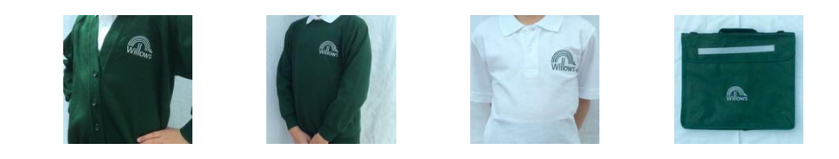

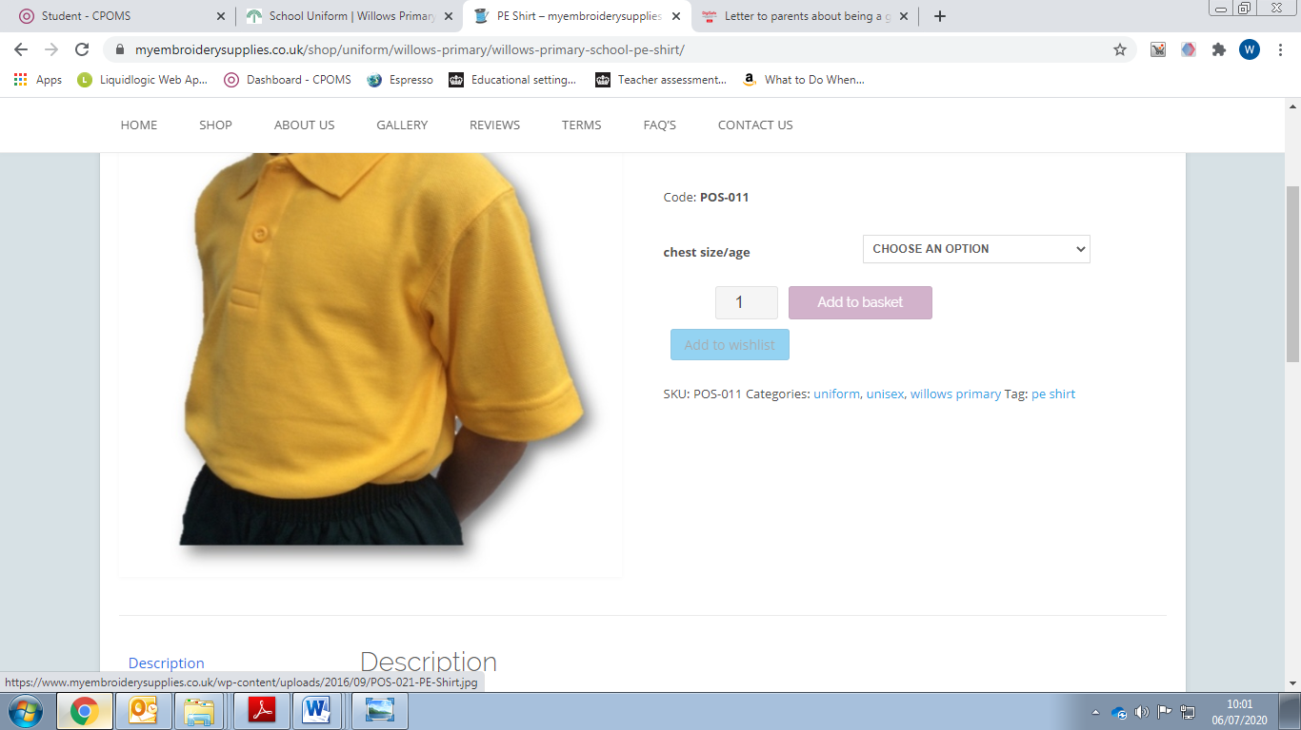
Uniform
Sales through uniform website www.myembroiderysupplies.co.uk
Or through PTA preloved uniform shop
Contact Mrs Pashley

Slide 9
School Readiness
To help your child prepare for school life here are a few things to practice over the summer…
Use the toilet and clean themselves independently (Please speak to school prior to your child starting if there are any toileting concerns)
Wash and dry their own hands
Wipe their own nose
Put on/ fasten their own coat/shoes.
Be away from their parent/carer, knowing they will come back soon
Use a spoon, knife and fork
Drink from a water bottle/ open cup
Follow simple instructions
Share and take turns with others
Recognise their own name
Enjoy listening to stories and rhymes.
Sing nursery rhymes
Use please and thank you
Notes:
Independence – putting on own coats, dressing/undressing selves, good toilet habits

Slide 10
A New Start…
We know that starting a new routine can be daunting for both adults and children and we will work together to make this as smooth as possible. Please be reassured that your child may be a little anxious initially or even have a few tears and this is natural on the first few days.
In order to help your child with their new routine please spend time preparing them by practicing getting ready for school in the days before they start.
Try on the uniform / Do a walk to school /Talk about what will happen on their first day /Show them where they will go into school and where you will collect them from.
To support your child’s separation from you into school be clear and use positive language (both verbally and with your actions) For example;
Give your child a hug/ kiss and say goodbye /Tell them it is time for school and to have fun /Reassure them by telling them who will collect them.
It is important that you don’t stay after you have said goodbye, this tells your child you do not feel sure about leaving them and your child will pick up on this anxiety.
We will always phone you if they do not settle and will work with parents to provide extra support where needed. Please talk to a member of staff if you need any help preparing your child for their first day, we are here to help.

Slide 11
Lunches
Nursery bring their own packed lunch. No cans or drinks high in E-numbers,
no chocolate, grapes or nuts please.
Reception children are entitled to a free school meal (You can provide your own packed lunch if you wish) Meals are selected by parents using an online system.
Snack
National fruit scheme (1 piece per day)
Please bring a filled water bottles (Reception only) with water only please and clearly named. Nursery have constant access to water.
‘The little extras’
EYFS Fund (Voluntary)- Suggested amounts £1 per week, £5 half term, £10 a term
Online payments Mrs Kelly (Details in the booklet)

Slide 12
Communication
‘Open door’ policy
  * teacher/TA the first port of call
  * phone call / appointment / pop in
  * email / book bag note
Absences
  Illness
  Please telephone on 1st day
  Send letter/email of explanation on return
  Requests for time out
  Headteachers are not allowed to authorise holidays during term time unless there are exceptional circumstances.
Online Learning Journey
We use an online system where the children’s learning is shared with parents.
You will be able to view all of your child’s observations and photographs. You can also add your own comments to the observations and you can post your own observations from home. We also post a weekly newsletter to inform parents about the activities and the learning for the coming week.

Slide 13
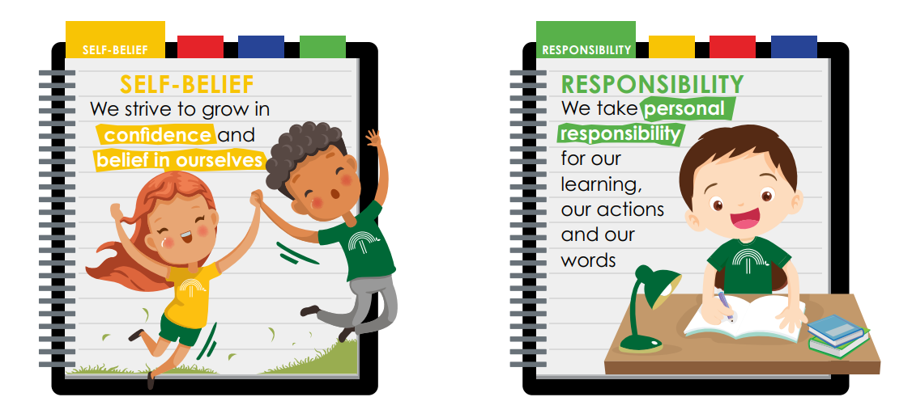

Willows Values

